Slide 1
45 Day Check-in and Preparing for Budget Development
GO Team Business Meeting #3

Slide 2
Agenda
Continuous Improvement Plan
45 Day Check-in
Fall to Winter MAP Data Discussion
Review of Strategic Plan and priorities progress
Strategic Plan Updates
Preparing for the Budget Development
Rank Strategic Priorities

Slide 3
Timeline for GO Teams
You are HERE
Fall 2021
GO Team Developed 2021-2025 Strategic Plan
1
Summer 2023
School Leadership completed Needs Assessment and defined overarching needs for SY23-24
2
August 2023
School Leadership completed 2023-2024 Continuous Improvement Plan
3
Sept. – Dec. 2023
Utilizing current data, the GO Team will review & possibly update the school strategic priorities and plan
4
Before Winter Break
GO Team will take action (vote) on the school’s strategic plan and vote on the ranked strategic plan priorities for SY24-25 budget discussions.
5
1
2
3
4
5

Slide 4
Continuous Improvement Plan

Slide 5
Quarterly CIP Check-in
As part of the Continuous Improvement process, all APS schools are completing a quarterly check-in for the Continuous Improvement Plans.
Questions to Consider
Based on our year long CIP plan, what are the actions that the school has already completed?​
What data supports the completion of an action step and success criteria (both implementation and student achievement)?

Slide 6
CIP Quarterly Check in
Literacy
Math
Whole Child
Steps:Mandatory phonics block for k-3
Provide realtime feedback and coaching to teachers
Continue Gifted Collab modelproviding inquiry based instruction
**All in progress until May
Steps:Create additional 45 minute planing period for Math prework and data analysis
Continue PLC process that requires model lessons and data for grouping
**All in progress until May
Steps: employ attendance Team and Care Team for student support
Continue Full time MTSS position
**All in progress until May

Slide 7
Data Discussion

Slide 8
Fall MAP Results
Before Presenting to your GO Team:
Insert School’s 2023 Fall MAP Results – use as many slides as necessary

Slide 9
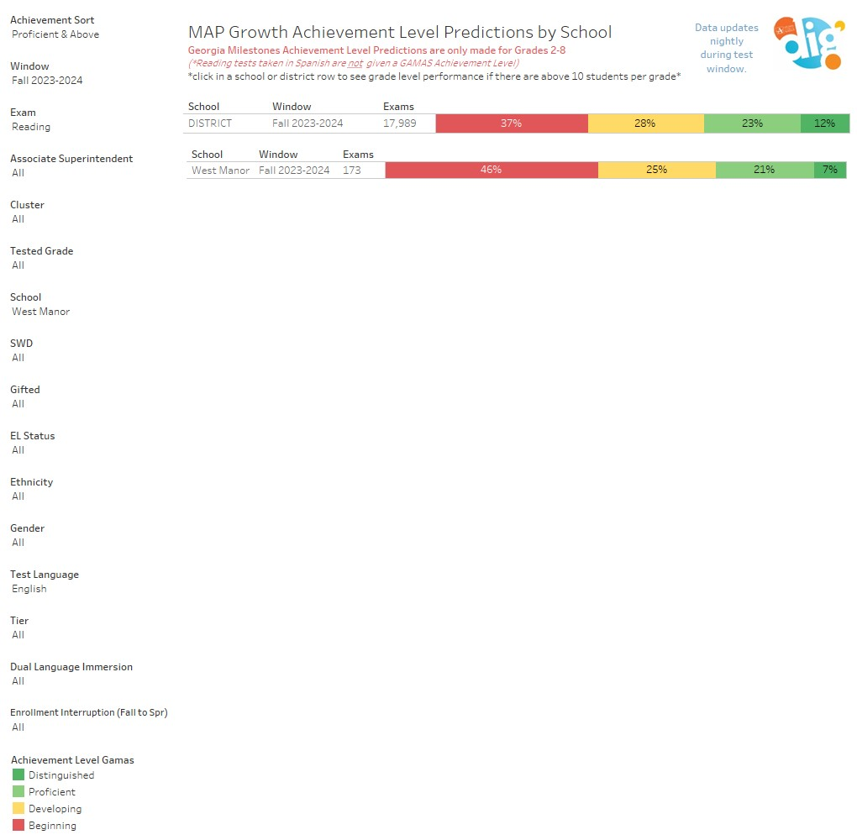
Fall MAP Results

Slide 10
Fall MAP Results Math

Slide 11
Winter MAP Results
We will Take the Winter MAP exam beginning the week of 11/28 and discuss Results at our next GO Team meeting

Slide 12
Strategic Plan Progress

Slide 13
West Manor IB World School
SMART Goals
Increase the % of grades 3-5 students scoring proficient or above on Milestones/ MAP in reading by 3%
Increase the % of grades 3-5 students scoring proficient or above on Milestones/MAP in math by 3%
Increase the percentage of students with 10 or less absences by 3%
APS Strategic Priorities & Initiatives
School Strategic Priorities
School Strategies
Fostering Academic Excellence for All
Data
Curriculum & Instruction
Signature Program
1.
3.
1A. Implementation of an intervention block to reduce gaps in learning
1B. Employ a literacy block with phonics for grades k-2
1C. Create PLC planning time for teachers to internalize standards and plan for instruction
Increase student phonic awareness and create early readers
Increase student knowledge in numbers and operations domain
Increase student multiplication skills
Building a Culture of Student Support
Whole Child & Intervention
Personalized Learning
Increase student attendance and decrease suspension rate
TBD: Create an attendance team to monitor and address attendance concerns, Create a Care Team to address student needs
TBD: Utilize SLC practices and restorative justice with the Counselor to reduce suspensions
Equipping & Empowering Leaders & Staff
Strategic Staff Support
Equitable Resource Allocation
Increasing Teacher knowledge of Standards
Increase Teacher knowledge of IB Program
TBD: Monthly IB training for staff, Professional development individualized around teacher needs in reading and math, training for phonics program (Fundations)
Ongoing PD for SEL, restorative practices, and trauma
Creating a System of School Support
Collective Action, Engagement & Empowerment
TBD: Conduct data meetings in PLC, with parents and students. Students will also have goal setting meetings with teachers
--Increase Parent Liaison and Social Worker positions to full time to support the needs of students and parents
Improve stakeholder knowledge of school data and how to assist
Provide support to students and stakeholders in need

Slide 14
Activity & Discussion
GO TEAM DISCUSSION: Review the priorities and goals in your strategic plan and reflect on if the expected progress is being made. These guiding questions will help you determine what, if any, updates are needed for your school’s strategic plan.
What progress has been made towards the priorities identified in our Strategic Plan? What evidence/data do we have?
Based upon available data, are there any other adjustments we need to make to the Strategic Plan?

Slide 15
Updates to the
Strategic Plan
Enter all changes/updates to your plan – be sure to include accountability measures, as appropriate.

Slide 16
Action on the Updated Strategic Plan
The GO Team needs to TAKE ACTION (vote) on its updated Strategic Plan. After the motion and a second, the GO Team may have additional discussion. Once discussion is concluded, the GO Team will vote.

Slide 17
Preparing for Budget Development

Slide 18
Strategic Plan
Priority Ranking
Insert the school’s priorities from Higher to Lower
Higher
1.Increase student phonic awareness and create early readers
2 Increase student knowledge in numbers and operations domain
3. Increase student multiplication skills
4. Increase student attendance and decrease suspension rate
5.Increasing Teacher knowledge of Standards
Increase Teacher knowledge of IB Program
7. Improve stakeholder knowledge of school data and how to assist
9. Provide support to students and stakeholders in need
Lower

Slide 19
Action on the Strategic Plan Priorities
The GO Team needs to TAKE ACTION (vote) on its ranked Strategic Plan Priorities. After the motion and a second, the GO Team may have additional discussion. Once discussion is concluded, the GO Team will vote.

Slide 20
Where we’re going
At our next meeting we will begin the discussion of the 2024-2025 budget.
Let me or the Chair know of any additional information you need for our future discussion.

Slide 21
Thank you

